Slide 1
Preventative maintenance and asset management
Municipal Engineers Association Conference and AGM, Toronto, Ontario
November 17, 2022
Presented by Arup Mukherjee, P.Eng.

Slide 2
Todays Objective
Reinforce message
Information and strategy
CONVINCE your decision makers – MORE $ for Preventative Maintenance
REALLOCATE $ not MORE $

Slide 3
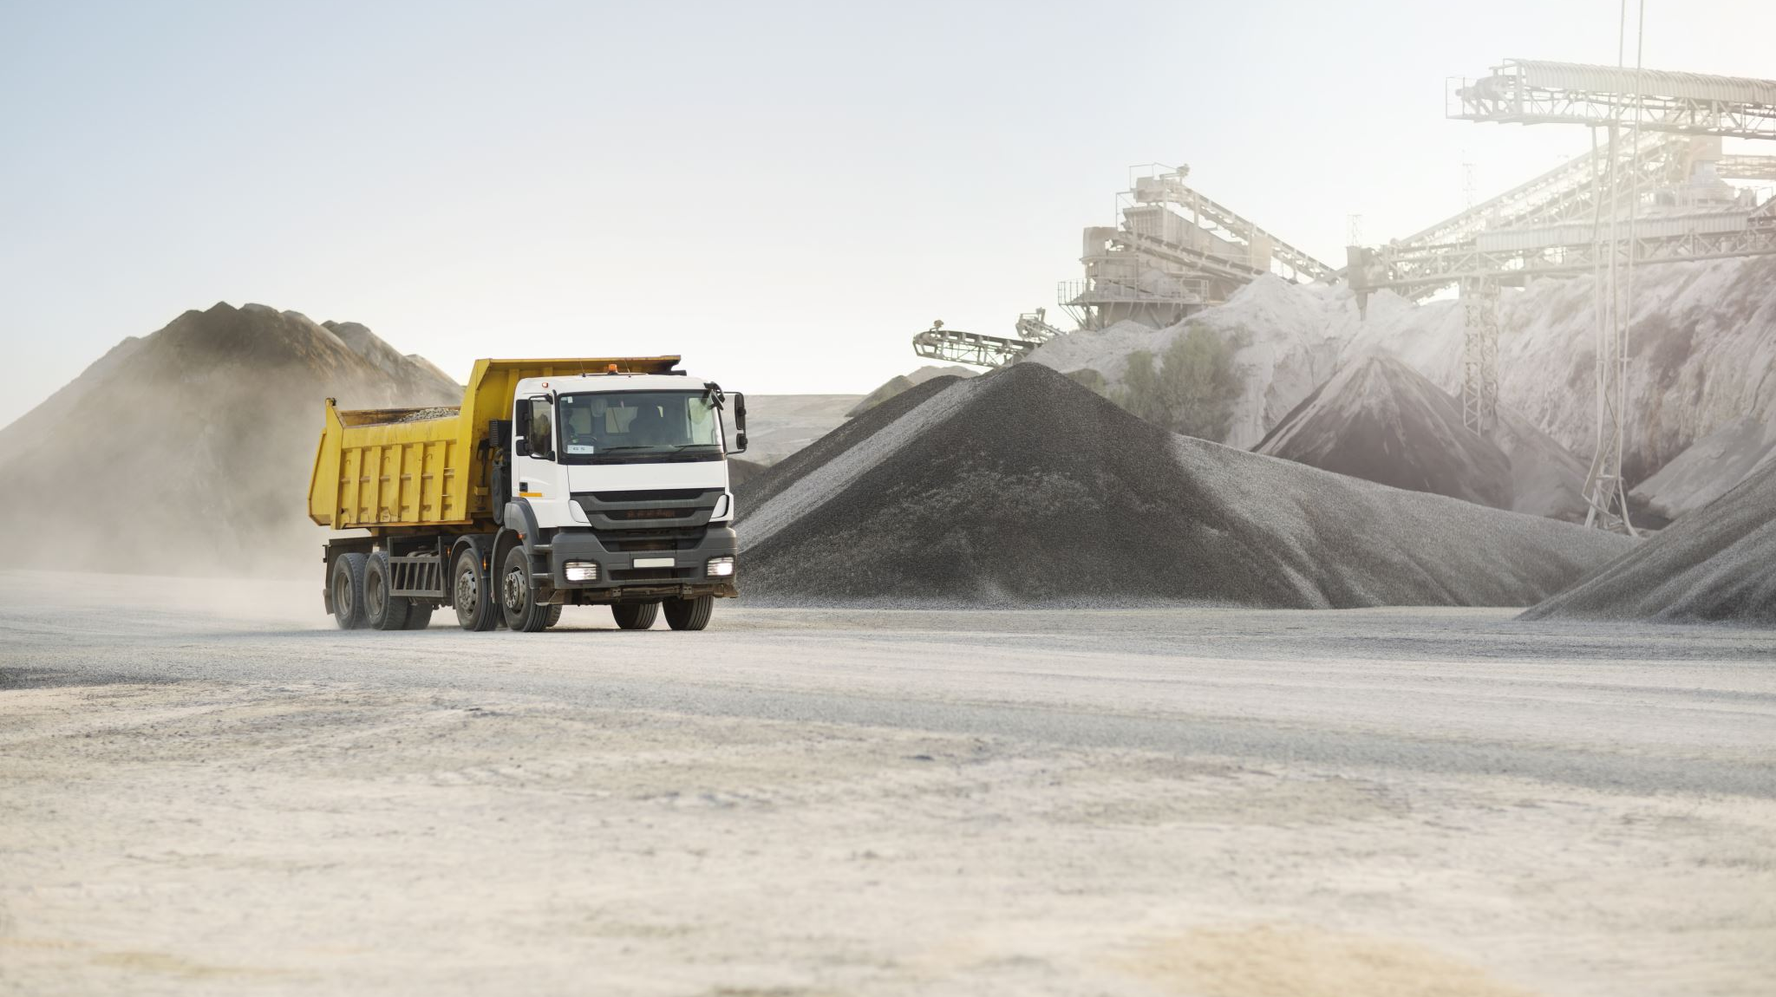
preventative maintenance
MINOR treatment to extend pavement life
Does not involve the removal and replacement of asphalt
Treat the asphalt. Delay asphalt removal or replacement
Occurs between typical asset management treatments such shave and pave, cold in place recycling, or pulverize and pave,

Slide 4
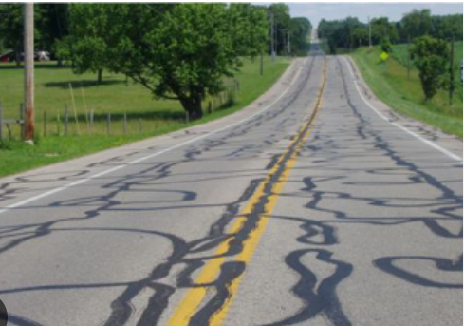
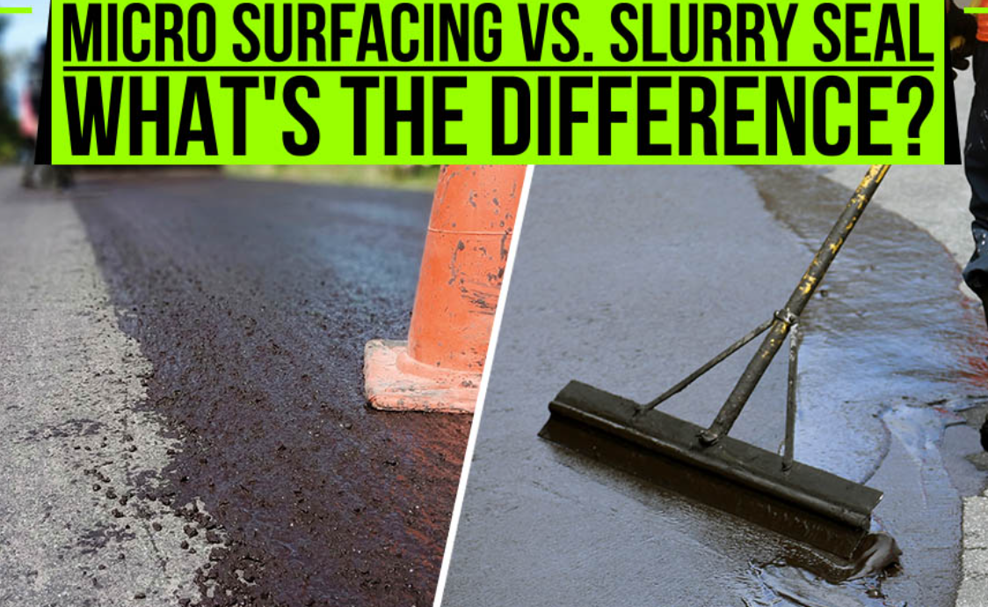
Typical exAMPLES OF PREVENTATIVE MAINTENANCE
Crack seal
Slurry seal
Microsuracing
Thin Overlay

Slide 5
Another example of preventative maintenance
Ditching for rural roads
Doesn’t require a contractor
Use your own resources
Part of your regular maintenance
Removes standing water, aesthetic value for residents

Slide 6
Potholes the beginning of the end

Slide 8
WATER
Arup Mukherjee

Slide 10
For roads Water is death

Slide 11
Road Structure
Four components of a road
Surface course
Base course
Subbase course
Subgrade

Slide 12
How ditching helps
sheet drainage
granular drainage
conveyance

Slide 13
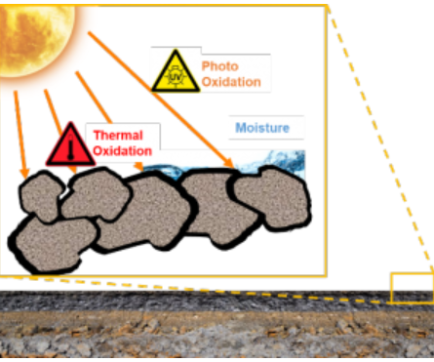
Another example of preventative maintenance – asphalt rejuvenation
Oxidation of asphalt cement starts immediately after paving
This chemical reaction removes Maltene, a chemical that provides for flexibility in asphalt cement
Asphalt becomes grey, brittle and breaks leading to water infiltration

Slide 14
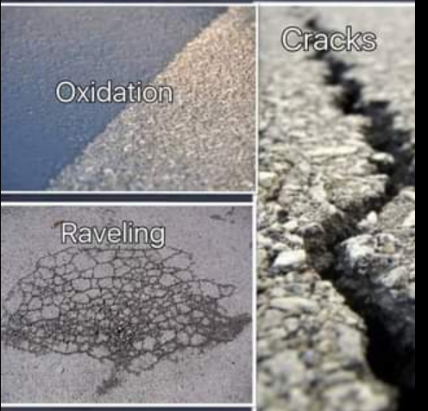
rejuvenation
Rejuvenation slows down oxidation
Introduces Maltene into the top 25mm
Maltene is the product that keeps asphalt flexible
Flexible asphalt is less brittle and not prone to cracking

Slide 15
Reclamite and crf are EXAMPLES OF REJUVENATION PRODUCTS
These products are applied as a spray to the asphalt surface
Operationally only involves single lane closure for a short duration
Lane can be opened within ONE HOUR
Increases the life of asphalt by 5-7 years
Waterproofs AND rejuvenates
Tightens cracks, uniform treatment across the roadway
Improves aesthetics – black asphalt top, public perception

Slide 16
Typical approach
Oxidation - Pavement greys and hardens
Microsurface, slurry seal
Cracking – crack sealing
Rest of road gets brittle
Cracking propogates – centre line, transverse, edge, map cracking, alligator cracking
Asphalt replacement

Slide 17
An alternative approach
Oxidation - Pavement greys and hardens
1. Apply Reclamite to rejuvenate asphalt
2. Potential for Microsurfacing
3. Further deterioration – CRF/Reclamite

Slide 18
Alternative approach Cost effectiveness
Rejuvenation could extend life by 5-7 years
At a fraction of the cost for typical approach
Reclamite/CRF is $14,000/km for a 2 lane road (7m wide)
¼ of the cost of the next available preservation option
Resurfacing = $100,000 plus plus plus
7mx1000mx.05m = 350 m3 x 2.4 T/m3 = 840 T x $120/T =$100,800 just for ASPHALT

Slide 19
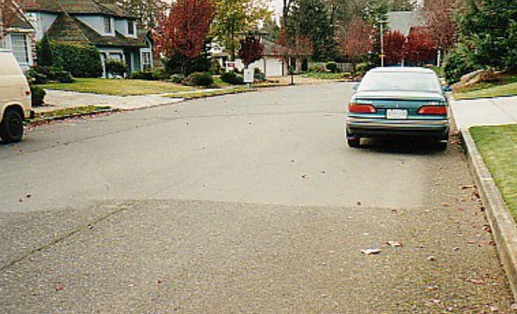
Examples of treatment

Slide 20
Examples of treatment

Slide 21
Examples

Slide 22
Due diligence
Talk to vendor
Local Municipalities
Trial
MTO Testing – Dynamic Shear Rheometry, Rotational Viscosity, Bending Beam Rheometry

Slide 23
Asset management legislation
Ontario Regulation 588/17
Ontario Regulation 193/21 extended deadline to July 1, 2022
Road condition indices required
Data can only be 2 years old

Slide 24
Asset management regulation
Mirror OSIM
Asses every 2 years
Mandatory for funding?
Are you ready?
in-house, consultants, costs

Slide 25
Oil change analogy
Frequency of oil changes – timing of improvements
Monitor the oil life – road condition
How you drive your car – aware of changing traffic or demands
Using the right oil – the right type of treatment

Slide 26
FINANCIAL REALITY CHECK
Asset management plan outlines medium and long term needs
Unlikely taxes can support long term plan
Inflationary preassures , budgets cannot keep up
Less infrastructure getting built , falling behind on overall plan

Slide 27
Preventative maintenance bridges the gap
PM helps to bridge the financial gap
Use it to preserve asphalt until the next treatment
PM is a tool to use when budget is limited.
A regular ongoing programme of PM is a powerful additional tool for Asset Management
In general, insufficient funds are dedicated to PM
Allocate a % of funds for Asset Management for PM

Slide 28
Take away from today
Value of preventative maintenance
Options for preventative maintenance
Recognize the challenging financial constraints
Inflationary costs – not keeping up with budget
Less infrastructure maintained
Need to make your roads last
Develop a strategy to stretch your asset management dollars
Provides time to “catch up” until funds available

Slide 29
Questions
Arup Mukherjee
Arup@arkim.ca

